Slide 1


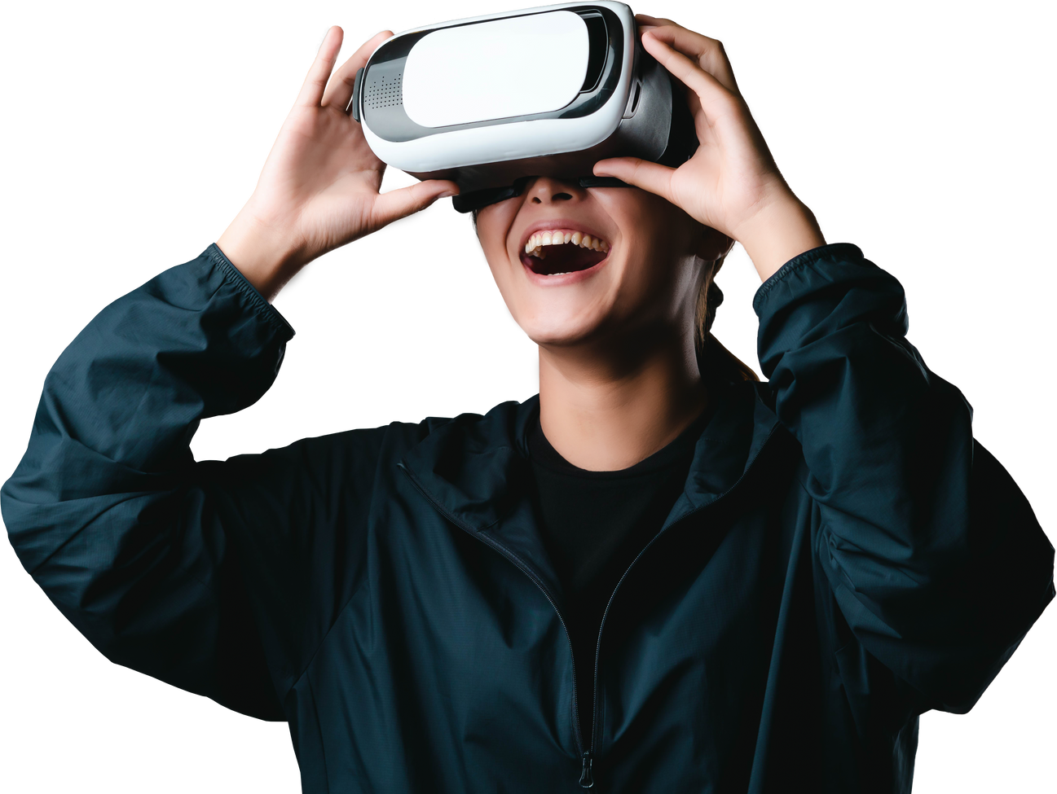
Applications of Augmented and Virtual Reality in Electrical Engineering Education: A Review
DOSEN PENGAMPU : HADZIQ FABROYIR, S.KOM., PH.D.
IRFAN ARMAWAN (6025231018)

Slide 2


Rimberio Co
OVERVIEW
This study evaluates the COVID-19 Pandemic and the urgent need for distance learning tools that, as closely as possible, mimic real training environments to motivate more research and investigation into AR/VR tools. In this work, we present a review of the application of augmented reality (AR) and virtual reality (VR) to electrical engineering education.

Slide 3

Rimberio Co
AIMS
This paper aims to review the application of AR and VR in electrical engineering higher education from an academic and industrial perspective. It does this by searching scientific databases and applications implemented in the Google Play Store.

Slide 4
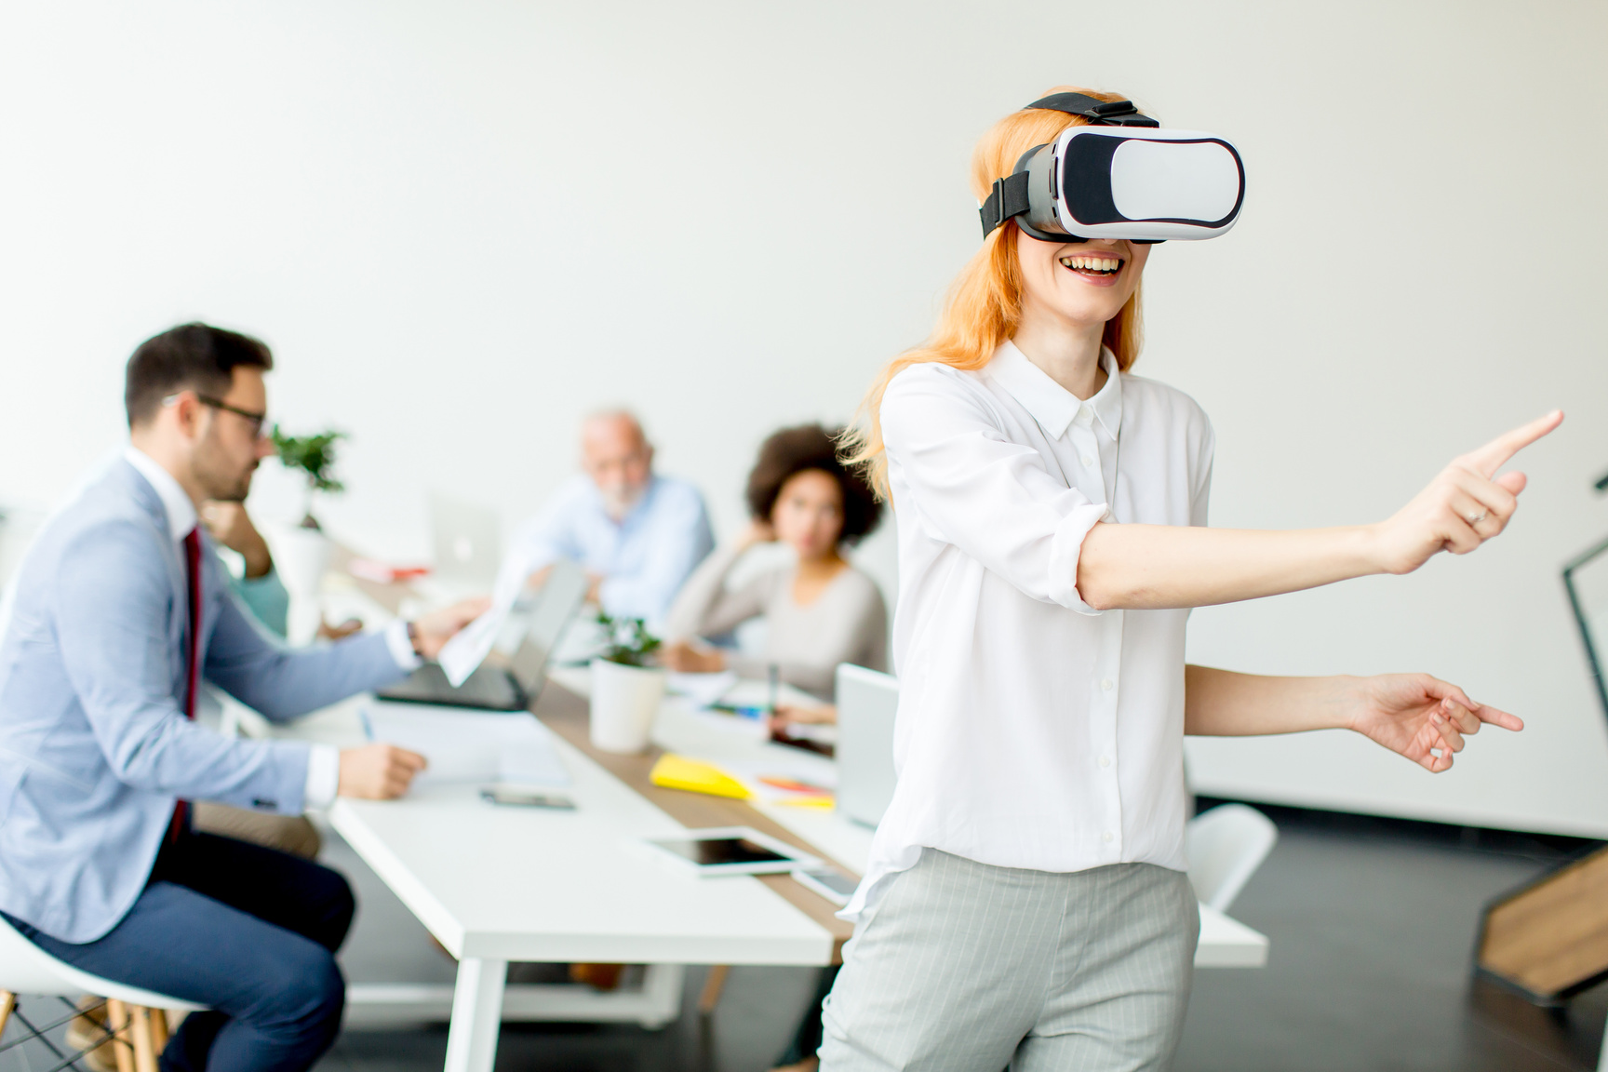

Rimberio Co
01
Methods
Discusses the flow of techniques handled using AR and VR
Hardware and software used
AR and VR applications are evaluated
Advantages and disadvantages of using AR and VR applications

Slide 5
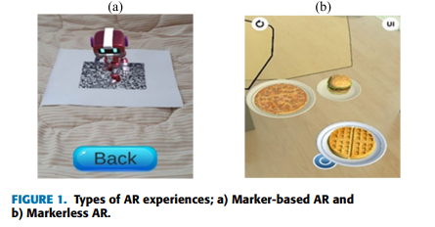

Slide 6
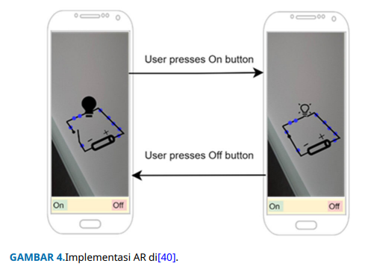
AR TECHNOLOGY IN ELECTRICAL ENGINEERING STREAMS

Slide 7
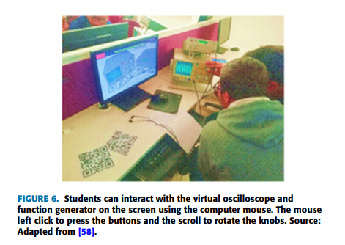

Slide 8
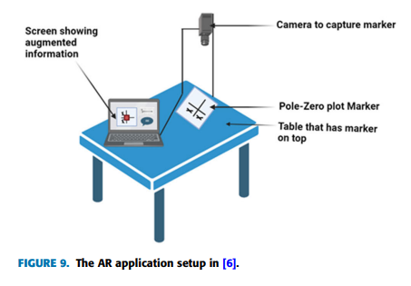

Slide 9
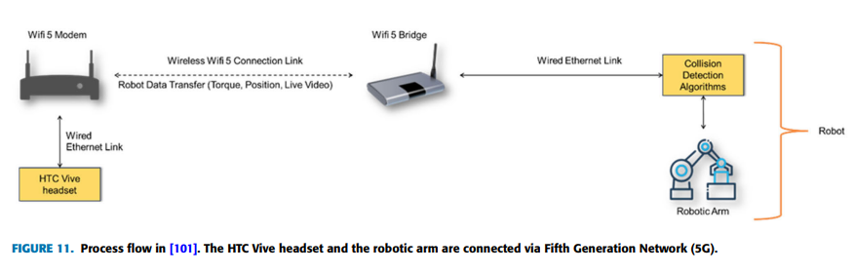

VR TECHNOLOGY IN ELECTRICAL ENGINEERING STREAMS

Slide 10
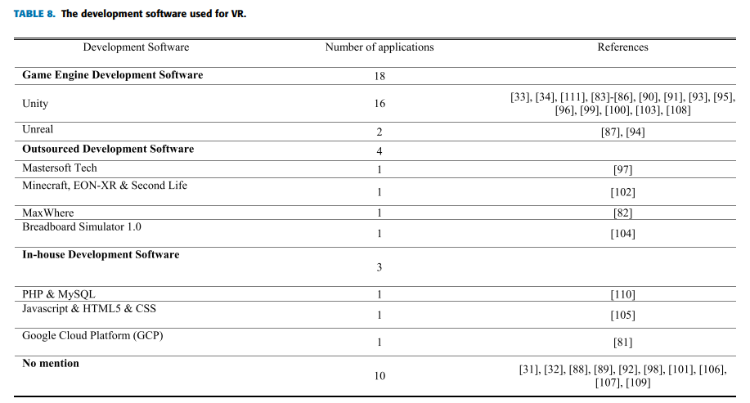

Slide 11
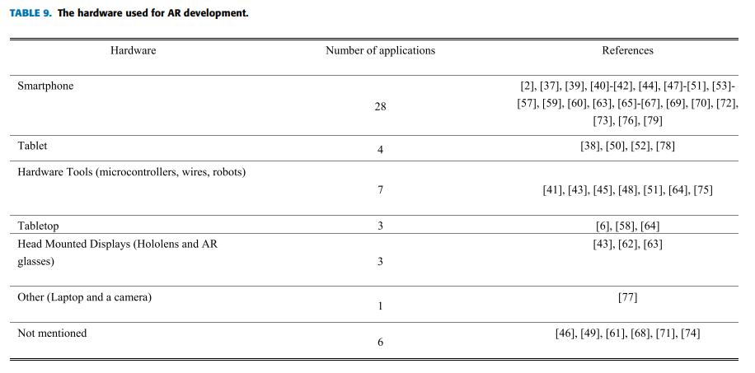

Slide 12
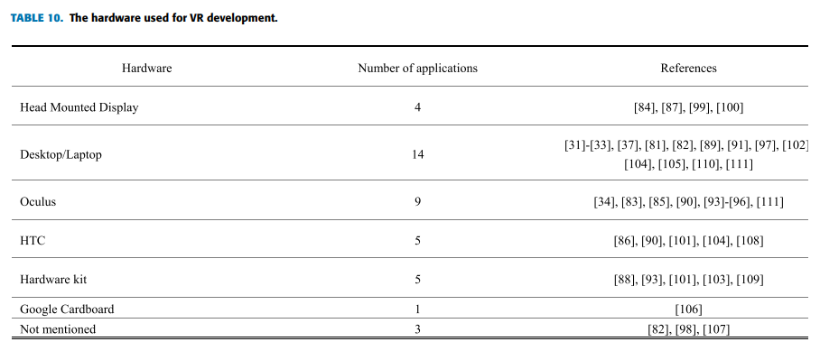

Slide 13
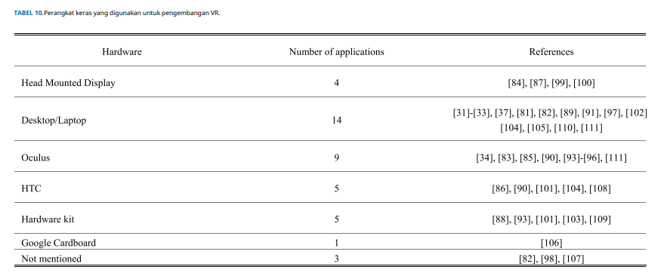

Slide 14
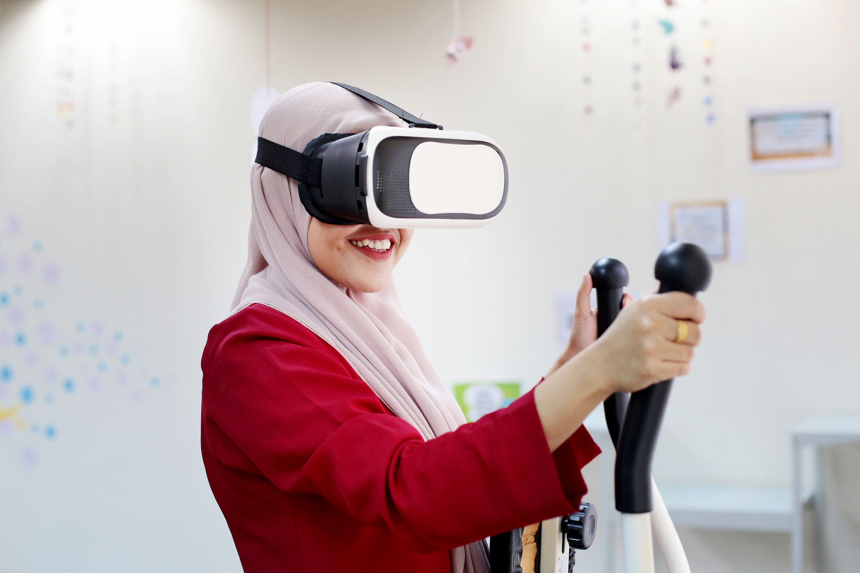
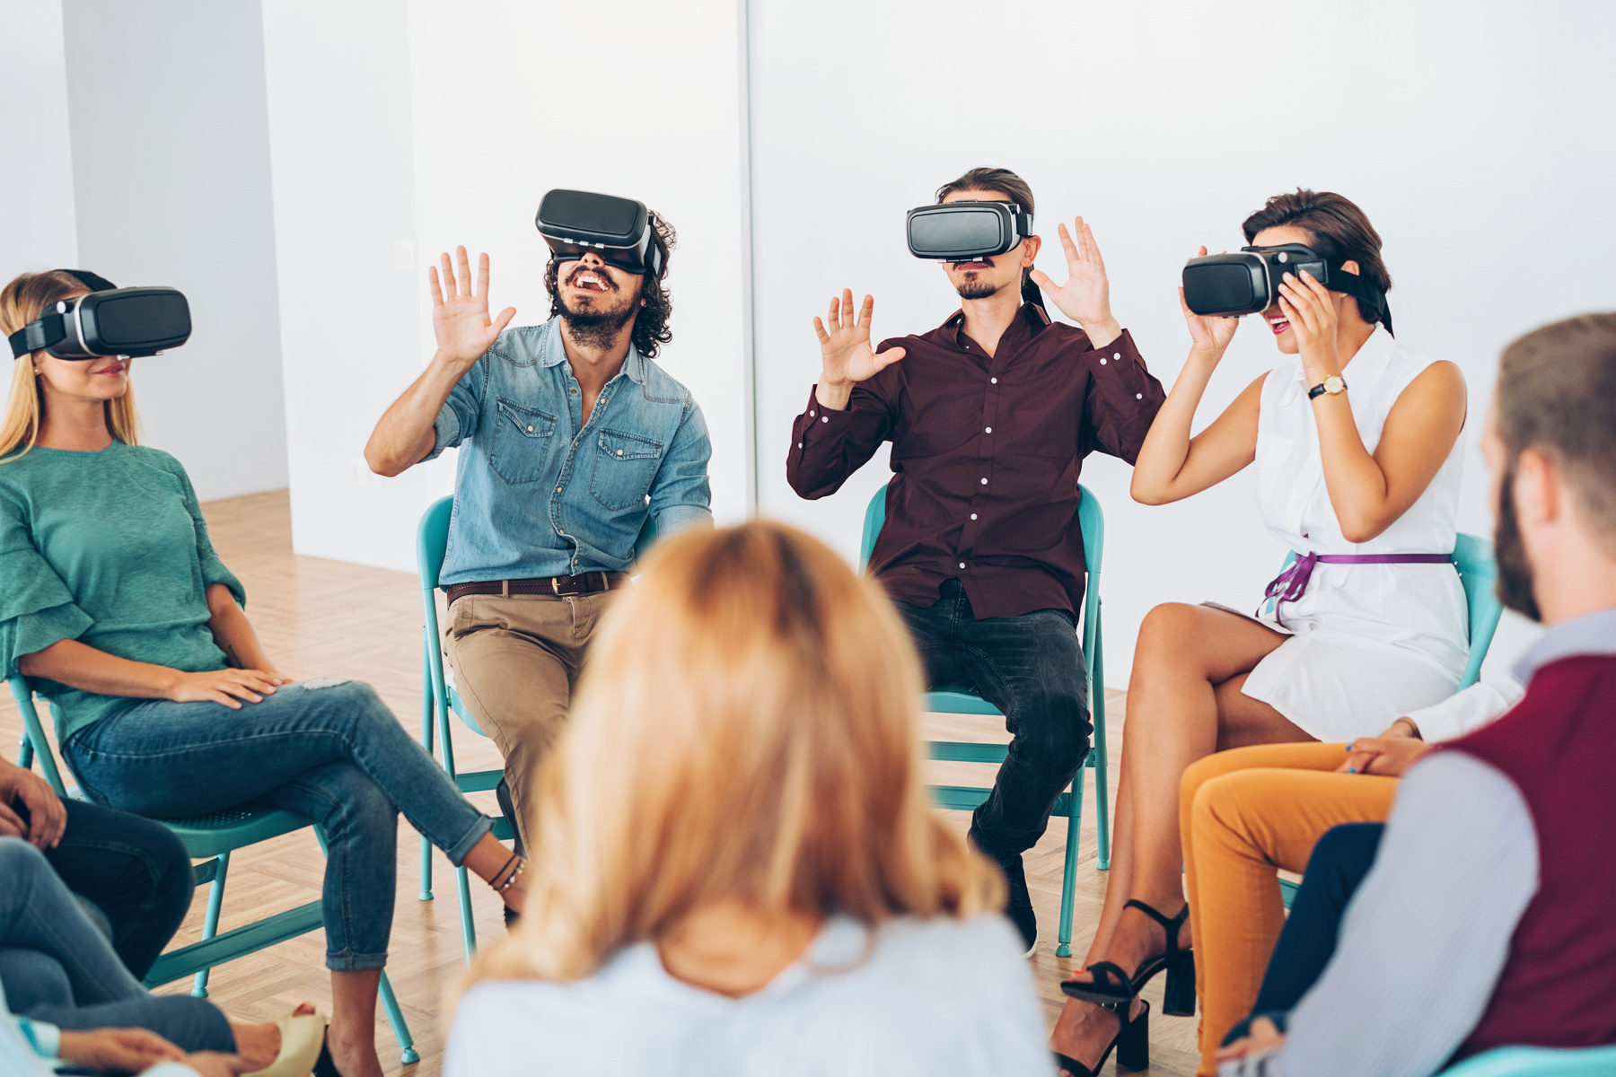
Rimberio Co
ASSESSMENT OF AR/VR APPLICATIONS IN ELECTRICAL ENGINEERING EDUCATION?
Learning theories, along with AR and VR applications, can further motivate students to use them. The two most commonly used learning theories in the articles reviewed are game-based and constructivist. The reference uses game-based learning theory by creating avatars, stories, levels, and badges in AR applications.

Slide 15
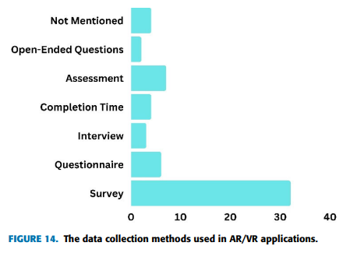

Slide 16
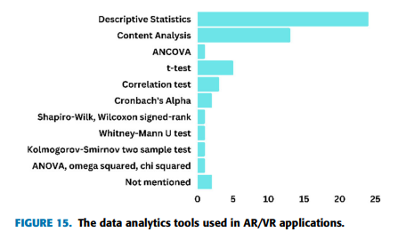

Slide 17
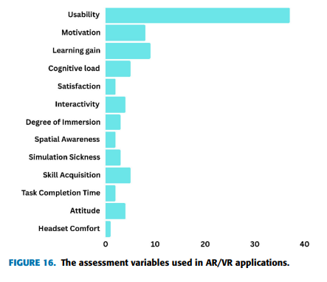

Slide 18
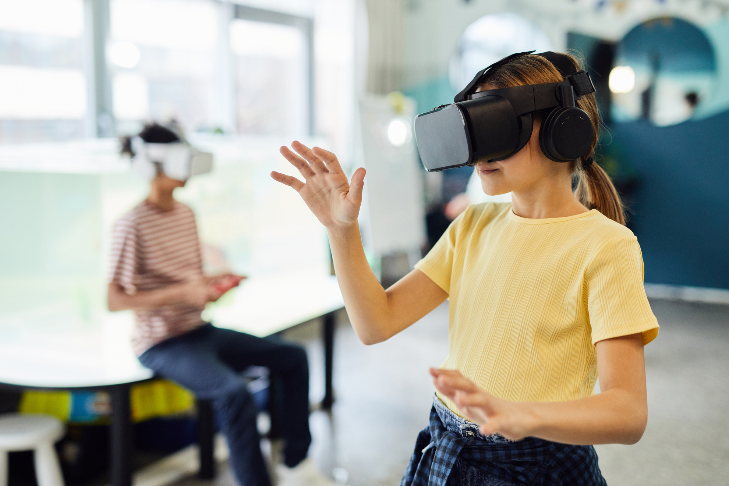
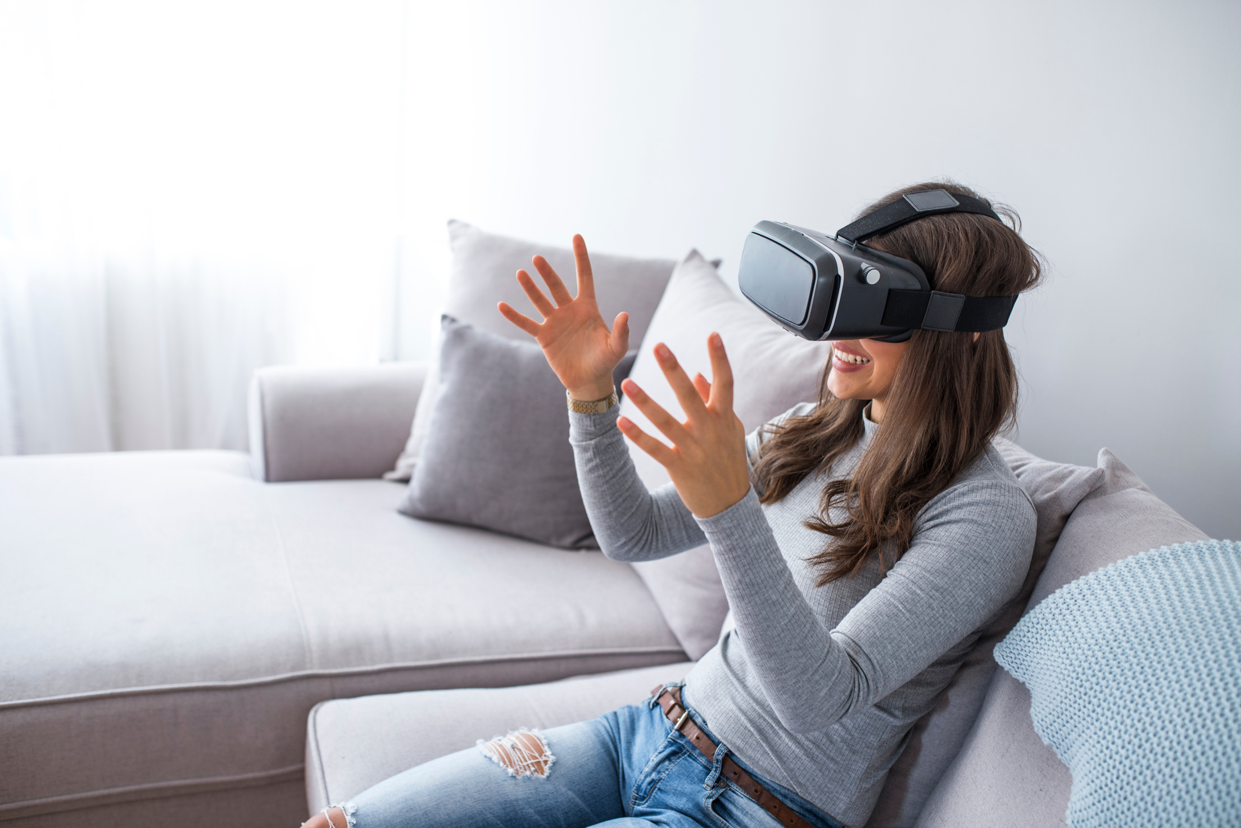
Rimberio Co
CHALLENGES OF USING AR/VR IN ELECTRICAL ENGINEERING EDUCATION
Some of the disadvantages of AR and VR are the price and learning curve to master the technology, misperceptions about VR (VR is only for gaming), and the low number of participants in VR applications due to the long time to conduct experiments.

Slide 19

Rimberio Co
Conclusion
This is the first review to discuss Augmented and Virtual Reality and its application in electrical engineering education. It has discussed various schools of electrical engineering, hardware and software technologies, evaluation methods, advantages, and challenges faced in AR/VR applications. Although this technology continues to develop, leveraging other industry 4.0 technologies, such as machine learning and cloud computing, as well as VR/AR, will improve performance and benefit society.

